Slide 1


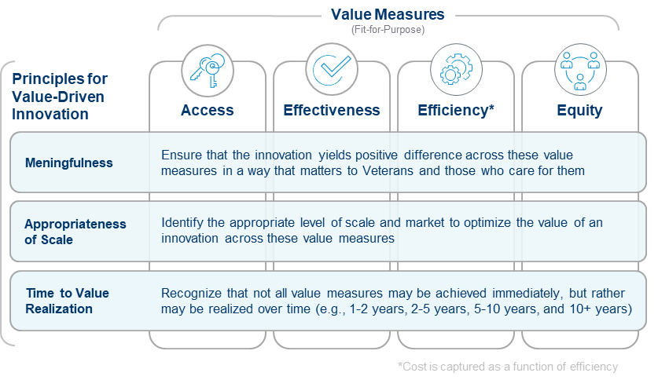



________________________ Demonstrating Principles for Value-Driven Innovation
Meaningfulness:
Appropriateness of Scale:
Meaningfulness
Time to Value Realization:
Read VA’s Value-driven framework for evaluating healthcare innovations with 4 case studies of the framework in action
Measuring the Value of ____________________________
Access:
Effectiveness:
.
Efficiency:
Equity:
If you use this framework and want to share your innovations with us, we'd be delighted to highlight and celebrate it. Share your story

